Slide 1
Content
Contents Map | page 1
Learning Objectives for Grade 9 B
Unit I : Tourism | page I
Unit 2 : Life and Culture | page 11
Unit 3 : it’s Showtime! | page 21
Unit 4 : Jobs | page 31
Club Corner | page 41

Slide 2
الــصــف : الصف التاسع المادة : اللغة الإنجليزية الفصل الدراسي : الثاني
Unit (1) - lesson 2
تقديم الأستاذة : امل احمد منازع
المؤهل الدراسي : بكالوريوس ألسن – تخصص لغه إنجليزية

Slide 3
Tourism in Oman
1
Read the newspaper article and complete activity 3 on page 4 of the Skills Book.
Sultanate set for sustainable tourism
Once again, the Sultanate of Oman is at the center of the development of tourism in the Gulf region. At a meeting in the region’s tourist industry, held at a major hotel in Muscat, Oman was praised for its wise policies in developing sustainable tourism. Mohammed Hussein, a tour agent, said, “Sustainable tourism is all about the long-term development of tourist activities which benefit local people without destroying the natural beauty of the region.
Unit 1 : Tourism
Grade : 9B English

Slide 4
Tourism in Oman
1
Read the newspaper article and complete activity 3 on page 4 of the Skills Book.
Sultanate set for sustainable tourism
It’s about finding the good things about tourism and making them better while avoiding problems which some tourists bring. "He continued, “Oman is blessed with a beautiful environment, fantastic scenery, fabulous culture, colorful traditions, and generous people. The things people want to see are the very things that have been lost in many tourist destinations in the Gulf. In Oman, we aim for quality, not quantity. "Oman hopes that sustainable tourism will bring investment and job opportunities into the Sultanate while helping to protect the things that make Oman the Pearl of Arabia.
Unit 1 : Tourism
Grade : 9B English

Slide 5
Activity
from Skills Book Page 4
Unit 1 : Tourism
Grade : 9B English

Slide 6
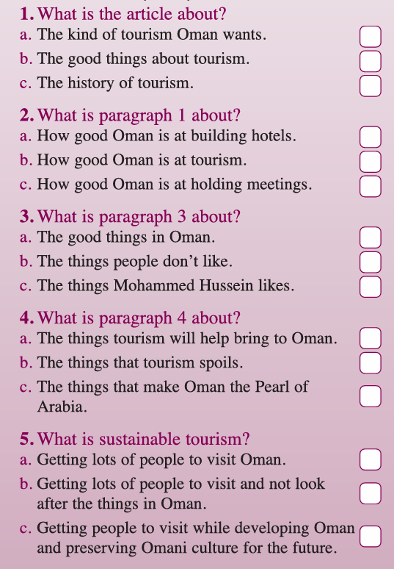
Activity from Skills Book
Read the text for activity 1 on page 4 of the Class book and then tick the correct answers in the space provided.
Unit 1 : Tourism
Grade : 9B English

Slide 7
Activity from Skills Book
Read the text for activity 1 on page 4 of the Class book and then tick the correct answers in the space provided.
Unit 1 : Tourism
Grade : 9B English

Slide 8
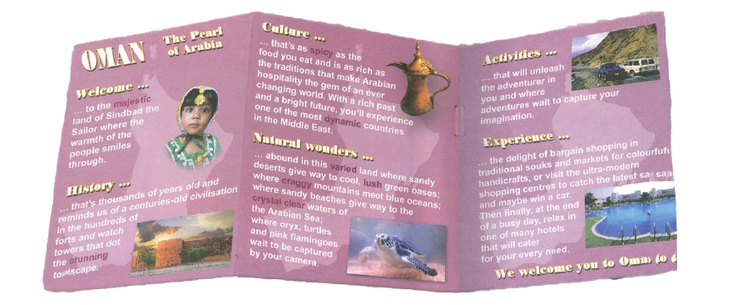
Tourism in Oman
2
Read the newspaper article and complete activity 3 on page 4 of the Skills Book.
Unit 1 : Tourism
Grade : 9B English

Slide 9
Tourism in Oman
3
Read the newspaper article and complete activity 3 on page 4 of the Skills Book.
Jobs
Ticket takers needed for Muscat Festival. Are you good at maths and looking after money? Do you speak good Arabic and English? Can you deal politely with large numbers of people? If so, we want you! Contact: Maya on 24834522.New jobs for waiters in big five-star hotel in Salalah for Khareef Season. Must be fluent in Arabic and English. Should be polite and have experience of working in hotels.
Unit 1 : Tourism
Grade : 9B English

Slide 10
Tourism in Oman
3
Read the newspaper article and complete activity 3 on page 4 of the Skills Book.
Jobs
Phone: Muna on 268745321.Wanted – experienced driver to lead tour parties on driving trips off the coast of Musandam. Should be able to speak good Arabic and English. Sailing experience preferred but not essential. Must be polite and reliable. Phone: Asrar on 24561721.Tour guide wanted to show holidaymakers around Salalah. Should be fluent in Arabic and English. Should be able to drive four-wheel drive vehicles. Must be polite and know about desert survival. Contact: Abdullah on 99331122.
Unit 1 : Tourism
Grade : 9B English

Slide 11
Unit 1 : Tourism
Grade : 9B English

