Slide 1
Content
Contents Map | page 1
Learning Objectives for Grade 9 B
Unit I : Tourism | page I
Unit 2 : Life and Culture | page 11
Unit 3 : it’s Showtime! | page 21
Unit 4 : Jobs | page 31
Club Corner | page 41

Slide 2
الــصــف : الصف التاسع المادة : اللغة الإنجليزية الفصل الدراسي : الثاني
Unit (1) - lesson 4
تقديم الأستاذة : امل احمد منازع
المؤهل الدراسي : بكالوريوس ألسن – تخصص لغه إنجليزية

Slide 3
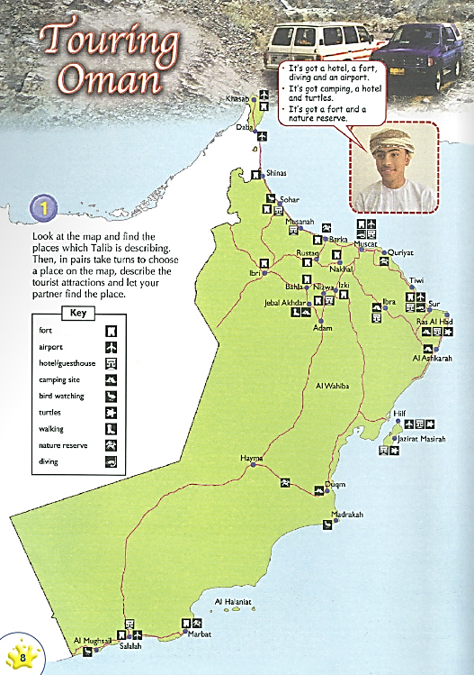
Touring Oman and Hotel Guide
• It's got a hotel, a fort, diving and an airport.
• It's got camping, a hotel and turtles.
• It's got a fort and a nature reserve.
Unit 1 : Tourism
Grade : 9B English

Slide 4
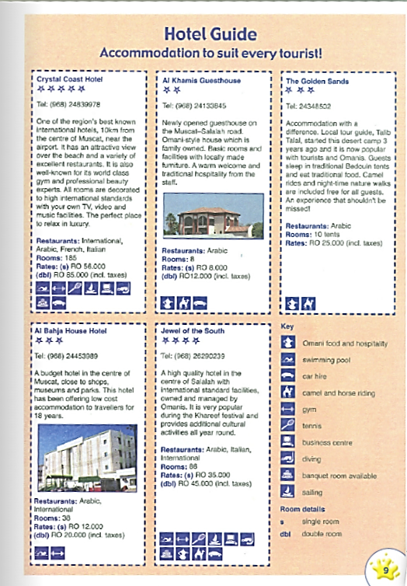
Touring Oman and Hotel Guide
Unit 1 : Tourism
Grade : 9B English

Slide 5
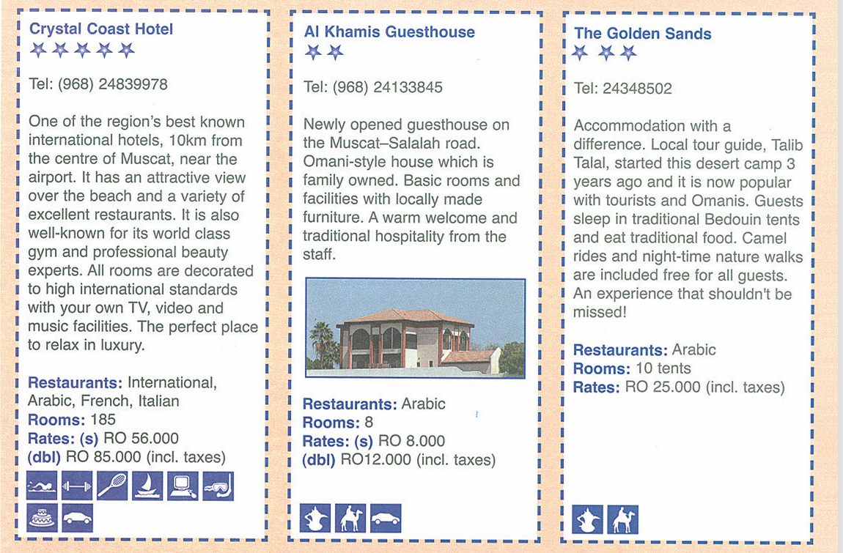
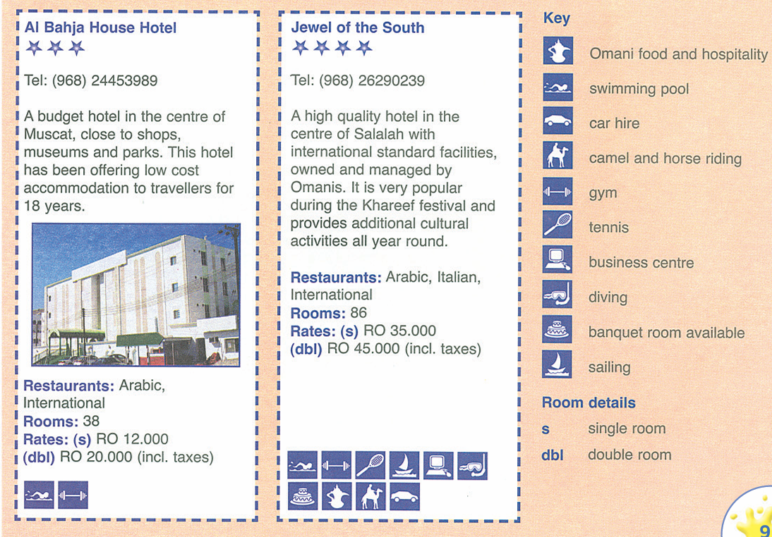
Touring Oman and Hotel Guide
Unit 1 : Tourism
Grade : 9B English

Slide 6
Tourist troubles
How can I help you ?
1
In pairs, take turns to be the hotel receptionist and the tourist. Use polite requests to solve some of the problems below.
I've lost my key. Please could you give me a key for my room?
Unit 1 : Tourism
Grade : 9B English

Slide 7
Tourist troubles
How can I help you ?
In pairs, take turns to be the hotel receptionist and the tourist. Use polite requests to solve some of the problems below.
1
You've lost the key to your room.
You need help carrying your bags.
You need to order a taxi to collect you at 3 o'clock and take you to the shops.
You want to change some rials tow pounds.
You want directions to the museum.
I've lost my key. Please could you give me a key for my room?
You want to change some rials tow pounds.
Unit 1 : Tourism
Grade : 9B English

Slide 8
Tourist troubles
How can I help you ?
In pairs, take turns to be the hotel receptionist and the tourist. Use polite requests to solve some of the problems below.
1
You want to know where the nearest post office is.
You need to get a doctor The telephone in your room is broken
You don't know when lunch is served. The people in the room next door are too noisy.
I've lost my key. Please could you give me a key for my room?
You have forgotten your room number.
Unit 1 : Tourism
Grade : 9B English

Slide 9
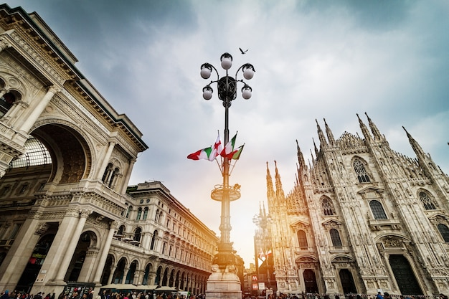
Tourist troubles
Zing’s Nightmare
2
Mustafa has written a fictional travel story about a character called Zing. The story has got mixed up. Read the paragraphs and put them in order in your exercise book.
a Zing dreamed that the plane had landed in Italy. He got off the plane and went into the airport to meet his friend.
b While he sat on the plane, he thought about meeting his friend and doing some sightseeing. It was a long flight and he soon fell asleep.
c After he left the airport he soon got lost. He took out his Italian phrasebook and politely asked alary for directions to his friend's house. The lady looked very confused and started shouting at him in English.
Unit 1 : Tourism
Grade : 9B English

Slide 10
Tourist troubles
Zing’s Nightmare
2
d The plane took off from Sydney and Zing felt really happy. He had spent three wonderful months touring Australia and now he was on his way to Italy, where he was going to meet a friend.
e Suddenly, Zing woke up. One of the cabin crew was tapping his shoulder and asking him if he wanted to eat something. He was relieved to find that the angry crowd had gone and he was still on the plane.
f He looked around the airport, but his friend was not there to meet him. After waiting for an hour, Zing decided to leave the airport and find his friend's house by himself.
g Soon a noisy crowd gathered around Zing and the lady. Zing felt scared and started shouting back at the crowd. The crowd moved closer and closer and they started pushing him and shaking him. Then, he felt a sharp tap on his shoulder.
Unit 1 : Tourism
Grade : 9B English

Slide 11
Unit 1 : Tourism
Grade : 9B English

