Slide 1
Revision

Slide 2
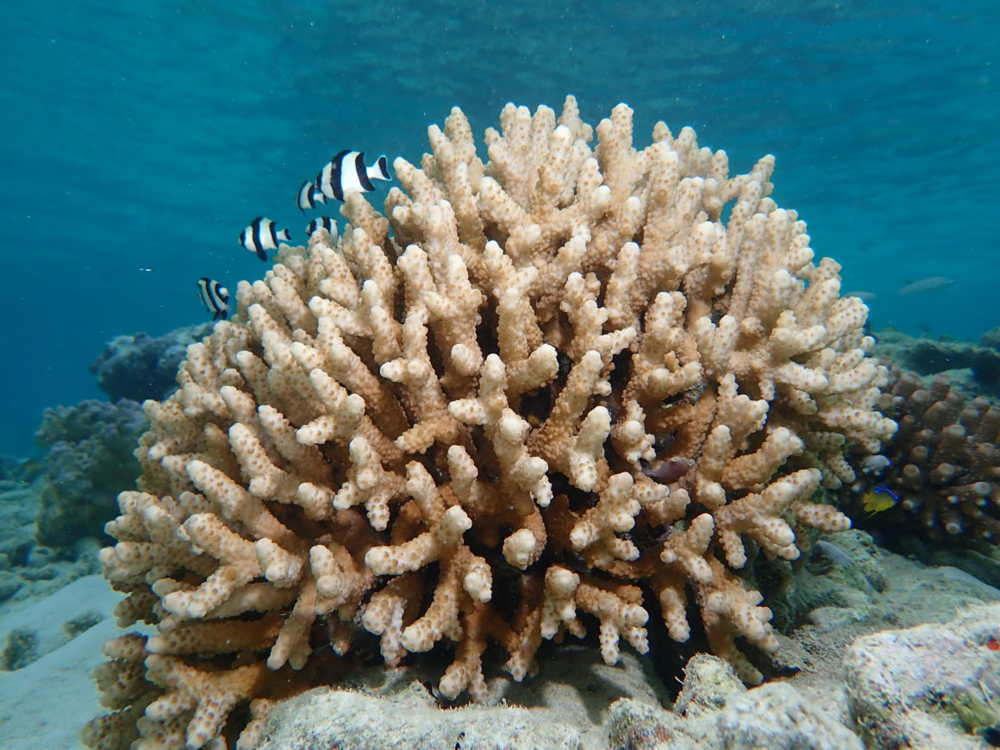
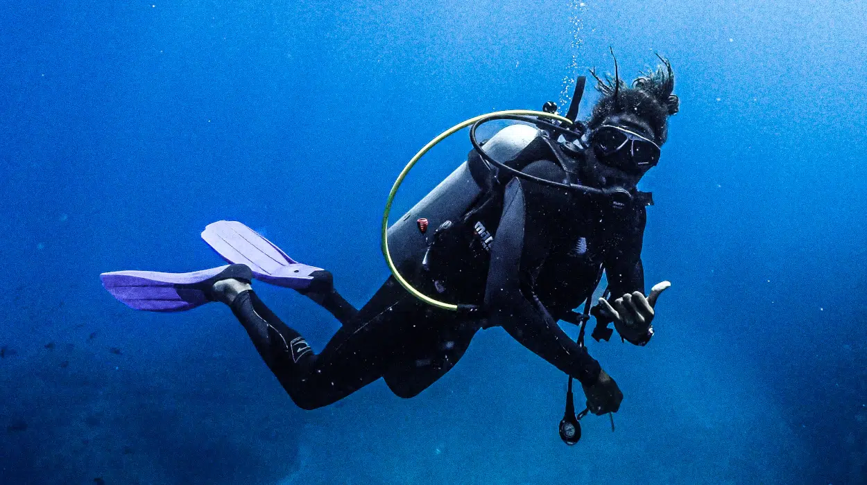
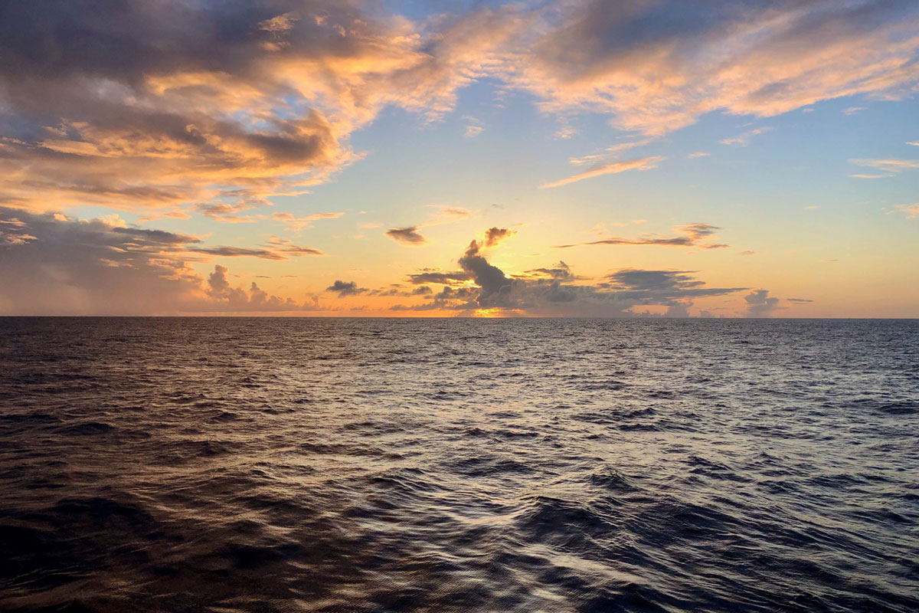
Vocabulary
- Whale
- Shark
Fish
- Ocean
- Diver
Corals
Float

Slide 3
How can we give an advice?
By using should.
Give examples.

Slide 4
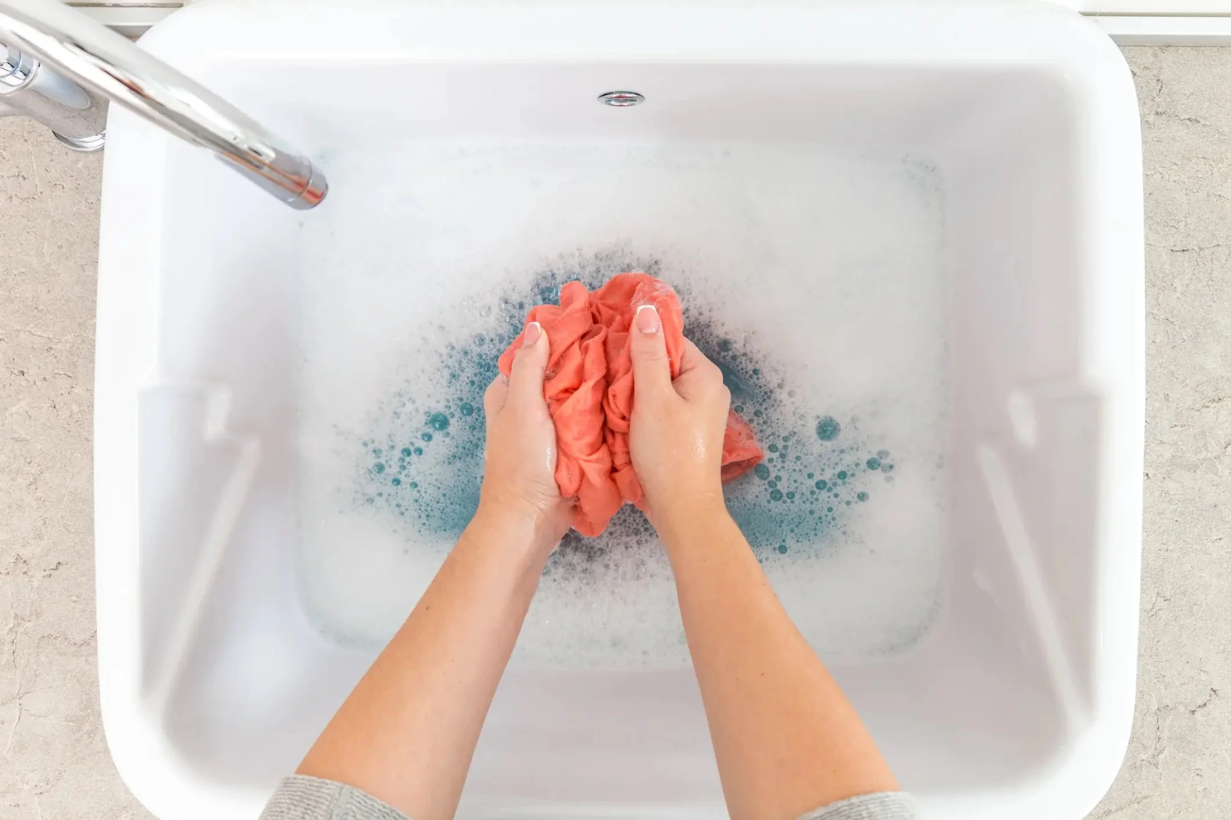
How can we save our planet?
1- By saving water.
= You should save water.
2- By washing clothes by hand not with a washing machine.
= You should wash clothes by hand.
3- By washing dishes with your hand not with the dishwasher.
= You should wash dishes with your hand.

Slide 5
Modals of obligation
Usage of Have to
For general low
You have to respect the rules.
You have to get a license to drive.
You have to pay the fine

Slide 6
Modals of obligation
Usage of must
For strong personal opinion
I must clean my house.
I must wake up early.
I must help my parents.

Slide 7
Exercise
1- You … drive on the right in Oman.
have to
2- My hair is very dirty, I … wash it.
must
3- They … pay a permit for Daminyat island.
have to
4- I … go shopping. There is no food in the house
must
5- I think we … protect our ocean.
must
6- we … stay at work until 4 o’clock
have to

Slide 8
Story time prophet Yunus
1. Why did Allah send prophet Yunus to the people of Ninevah?
To teach them how to be good and kind to each other.
Did they listen to Yunus?
No, they didn’t listen to him.
Where did Yunus go?
He got on a big ship.
How many days did Yunus spend in the stomach of the whale?
Three days.
5. What do we say when we make mistakes?
We must say sorry.

Slide 9
Thank you
Did you have fun?
What have we learned from this session?

